Slide 1

‹#›
Multi-Sport Case Analyses
Analyzing F1 Racing, MLB, NFL, and PGA data using Alteryx

Slide 2
‹#›
Major League Baseball (MLB)
Analyzing the 2022 Season

Slide 3

‹#›
MLB
Methodology
3 Data Sets:
Pitching statistics by pitch type and pitcher for the season.
Data on every pitch thrown by Angels Pitcher Shohei Ohtani during the season.
Batter performance by month.

Slide 4
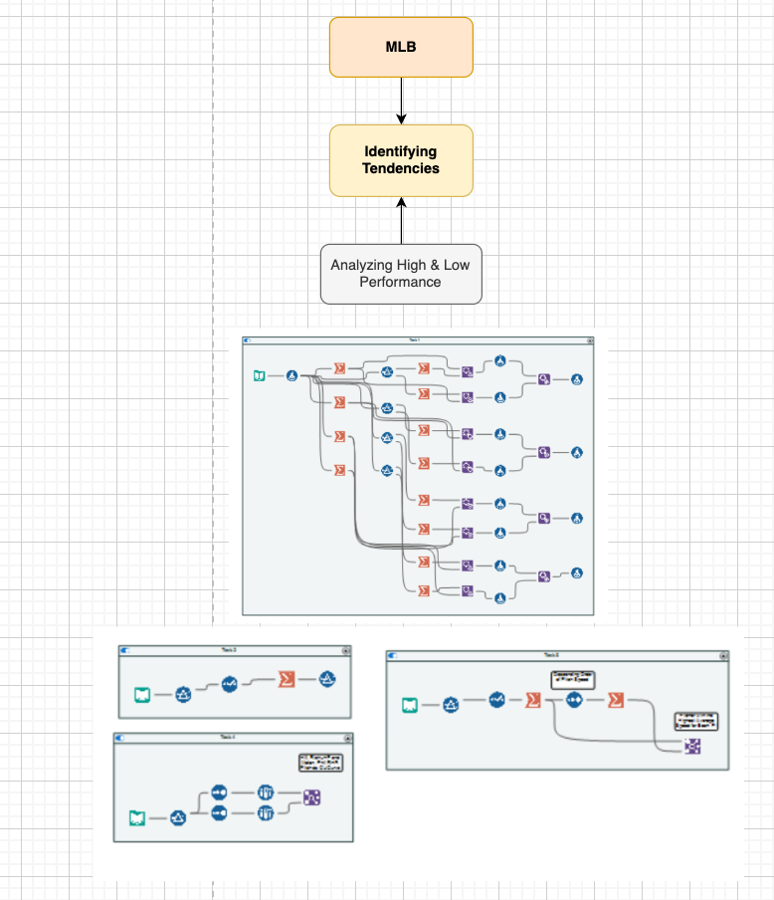

Slide 5
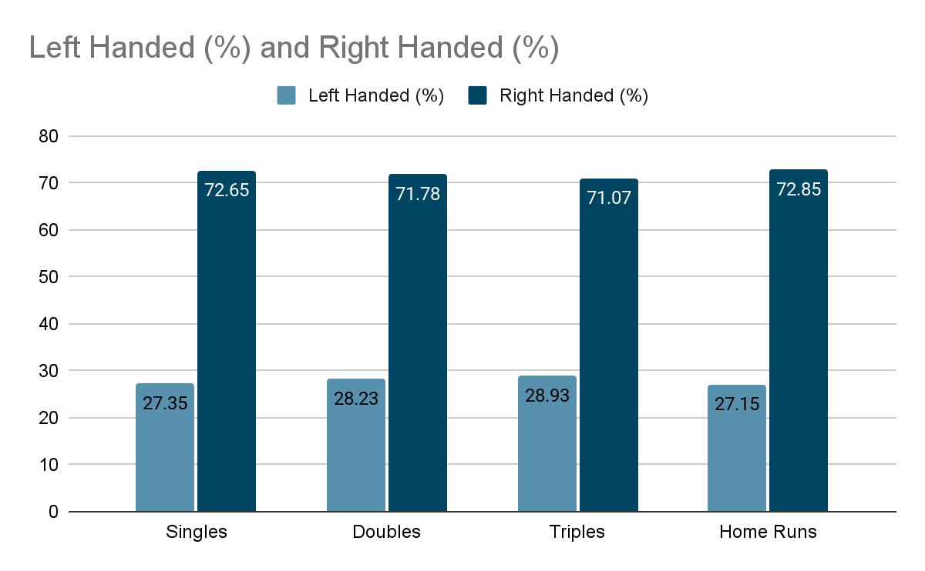
‹#›
MLB
Do Left Handed or Right Handed Pitchers Have An Advantage?
Which Pitch Type Has The Greatest Difference Between Left Handed and Right Handed Pitchers?
Single Hit Difference of 45.29%!

Slide 6
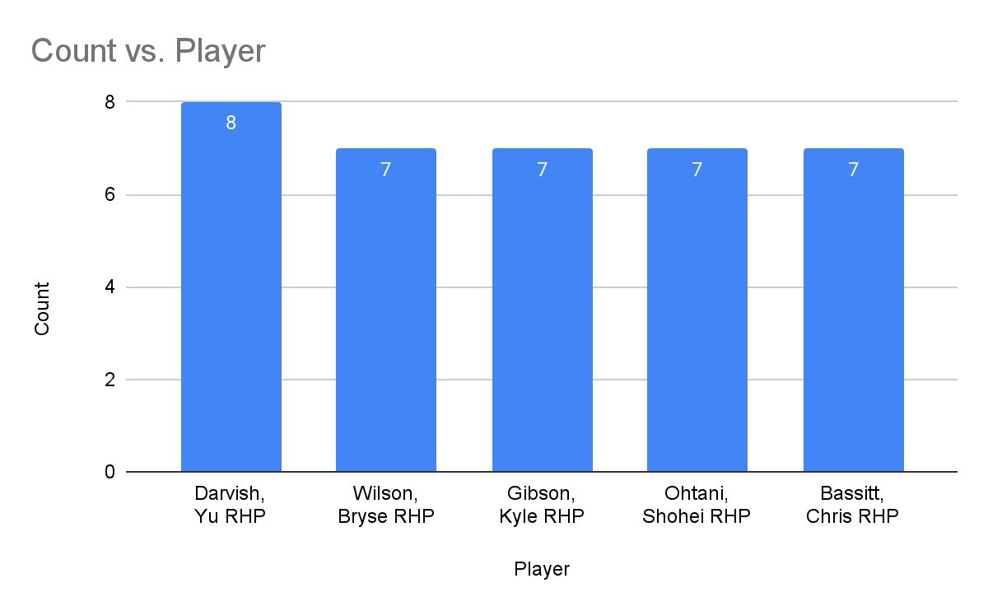
‹#›
MLB
How many pitchers have seven or more different types of pitches that they have thrown 50 or more times?

